Slide 1
Fundamentals of programming:
Seminar 6
Diyora Sayfutdinova – dsayfutdinova@wiut.uz
Computing Department

Slide 2
Quick Recap
How can we repeat instructions with little effort?
What is a loop?
What are the differences between For and While loops?
How can a range of integers be created?
How can a list of integers be created?
How can a loop be interrupted?
When we use break and continue?
Computing Department

Slide 3
For vs While Loops
for loop:
know the number of iterations
uses a counter
while loop:
unbounded number of iterations
can use a counter but must initialize before loop and increment it inside loop
Computing Department

Slide 4
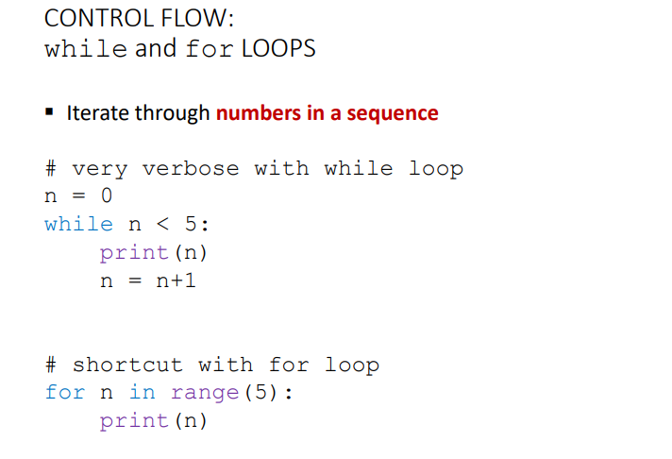
For vs While Loops
Computing Department

Slide 5
Use For|While Loops
Try it!
create a list of int from 1 to 40
  Print the numbers 1–9.
  Print even numbers from 2 to 20
  Print squares of numbers 1–10 in format n² = result.
  Count backwards from 10 down to 1.
Computing Department

Slide 6
Iterating Over Lists & Strings
Try it!
fruits = ["apple", "banana", "cherry"]
Print each fruit and its length.
Convert all fruit names to uppercase in-place using indices.
From "LoopingIsFun", print only vowels.
Combine lists: prices = [10, 20, 30], items = ["pen","book","bag"]
  Print pen → 10 USD etc.
Computing Department

Slide 7
Loop Control: break & continue
break → stops the loop early.
continue → skips current iteration.
Try it!
Iterate numbers 1–40: stop printing when you reach 21.
Iterate numbers 1–20: skip all multiples of 3 but print the rest.
text = "Search For the Capital letters"
Search a string for the uppercase letters; print their indices (print -1 if there is no uppercase characters)
  (stop at first found).
Computing Department

Slide 8
Nested For Loop
Try it!
Print full multiplication tables (1×1–10×10).
  Before the new multiplication table give the multiplication table’s name: “Multiplication table for 4”
Print a 5×5 grid of *
*****
*****
*****
*****
*****
Computing Department

Slide 9
For Loop
for i in range(len(data)) → When you need index as it uses indices for looping
for i in data → When you need values only,as it loops over elements in the iterable.
Computing Department

Slide 10
For Loop
Try it!
data = [["Anna", 19, "A"], ["Bob", 22, "B"], ["Cara", 21, "A"]]
Produce the following:
  0 ['Anna', 19, 'A']
  1 ['Bob', 22, 'B']
  2 ['Cara', 21, 'A']
get the names only
  Anna
  Bob
  Cara
get the each element on a single line
name:Anna
Age: 19
Grade: A
name:Bob
Age: 22
Grade: B
name:Cara
Age: 21
Grade: A
Computing Department

Slide 11
For Loop
Try it!
Create a right-angled triangle pattern of numbers:
  1
  1 2
  1 2 3
Computing Department

Slide 12
For Loop
Try it!
Write a program that prompts a user for a text then collects all uppercase letters into a new list and prints them joined as a string.
text = "Did You Count The Number of UppeR CaseS?"
Computing Department

Slide 13
For Loop
Try it!
Word Counter
  Prompt the user for a sentence. Count how many words (split by spaces)
  Count the words >= 5
Computing Department

Slide 14
For Loop
Try it!
  Duplicate Finder
    nums = [2,4,7,4,9,2,7,3]
    print which numbers appear more than once and how many times
Computing Department

Slide 15
Try it!
  ATM Cash Dispenser
    Input: an amount of money (positive integer)
    Output: how many 100, 50, 20, 10, 5, 1 bills to return
    It should return the amount requested using the minimum number of bills
Computing Department

Slide 16
Try it!
Mini Banking Ledger
  Keep a running balance starting at 0.
  Loop offering actions:
    D → deposit, W → withdraw, B → show balance, Q → quit.
  Reject withdrawals that would make the balance negative
Computing Department

Slide 17

Computing Department

